Slide 1
Dynamic Programming

Slide 2
Preliminary
Dynamic programming is due to Richard E. Bellman (1953)
Dynamic programming is an algorithm design method that can be used when the solution to a problem may be viewed as the result of a sequence of decisions
In mathematics and computer science, dynamic programming is a method for solving complex problems by breaking them down into simpler sub-problems (Wiki)

Slide 3
Fibonacci sequence
Fibonacci sequence: 0 , 1 , 1 , 2 , 3 , 5 , 8 , 13 , 21 , …
F_{i} = i if i ≤ 1
F_{i} = F_{i-1} + F_{i-2} if i ≥ 2
Solved by a recursive program:
Much replicated computation is done.
It should be solved by a simple loop.

Slide 4
Dynamic Programming
Dynamic Programming is an algorithm design method that can be used when the solution to a problem may be viewed as the result of a sequence of decisions

Slide 5
The shortest path
To find a shortest path in a multi-stage graph
Apply the greedy method :
the shortest path from S to T :
1 + 2 + 5 = 8

Slide 6
Shortest path in multistage graphs
e.g.
Greedy method cannot lead to an optimal answer to this case: (S, A, D, T) 1+4+18 = 23.
Optimal shortest path is:
(S, C, F, T) 5+2+2 = 9.

Slide 7
Dynamic Programming Approach
Dynamic programming
d(S, T) = min{1+d(A, T), 2+d(B, T), 5+d(C, T)}
d(A,T) = min{4+d(D,T), 11+d(E,T)}
= min{4+18, 11+13} = 22.

Slide 8
Dynamic Programming
d(B, T) = min{9+d(D, T), 5+d(E, T), 16+d(F, T)}
= min{9+18, 5+13, 16+2} = 18.
d(C, T) = min{ 2+d(F, T) } = 2+2 = 4
d(S, T) = min{1+d(A, T), 2+d(B, T), 5+d(C, T)}
= min{1+22, 2+18, 5+4} = 9.
The above way of reasoning is called
forward reasoning.

Slide 9
Backward Reasoning
d(S, A) = 1
d(S, B) = 2
d(S, C) = 5
d(S, D) = min{d(S, A)+d(A, D), d(S, B)+d(B, D)}
= min{1+4, 2+9 } = 5
d(S, E) = min{d(S, A)+d(A, E), d(S, B)+d(B, E)}
= min{1+11, 2+5 } = 7
d(S, F) = min{d(S, A)+d(A, F),d(S, B)+d(B, F)}
= min{2+16, 5+2} = 7

Slide 10
d(S, T) = min{d(S, D)+d(D, T),d(S,E)+
d(E,T), d(S, F)+d(F, T)}
= min{ 5+18, 7+13, 7+2 }
= 9

Slide 11
Dynamic Programming
Not a specific algorithm, but a technique
Developed back in the day when “programming” meant “tabular method” (like linear programming)
Used for optimization problems: Find a solution with the optimal value

Slide 12
Four-step method
Characterize the structure of an optimal solution.
Recursively define the value of an optimal solution.
Compute the value of an optimal solution, typically in a bottom-up fashion.
Construct an optimal solution from the computed information.

Slide 13
Principle of Optimality
Principle of optimality: Suppose that in solving a problem, we have to make a sequence of decisions D₁, D₂, …, D_{n}. If this sequence is optimal, then the last k decisions, 1 < k < n must be optimal.
E.g. the shortest path problem
If i, i₁, i₂, …, j is a shortest path from i to j, then i₁, i₂, …, j must be a shortest path from i₁ to j
In summary, if a problem can be described by a multistage graph, then it can be solved by dynamic programming.

Slide 14
Dynamic Programming
Forward approach and backward approach:
Note that if the recurrence relations are formulated using the forward approach then the relations are solved backwards, i.e., beginning with the last decision
On the other hand if the relations are formulated using the backward approach, they are solved forwards.
To solve a problem by using dynamic programming:
Find out the recurrence relations.
Represent the problem by a multistage graph.

Slide 15
Resource Allocation Problem
There are m resources available to n projects
profit p(i, j) denotes the profits attained through allocating j resources to project i.
Goal: Find an allocation that maximizes the total profit.

Slide 16
Multistage Graph
Resource allocation problem can be described as a multistage graph.
(i, j) : i resources allocated to projects 1, 2, …, j
e.g. node H = (3, 2) : 3 resources allocated to projects 1, 2.

Slide 17
Find the longest path from S to T :
(S, C, H, L, T), 8 + 5 + 0 + 0 = 13
2 resources allocated to project 1.
1 resource allocated to project 2.
0 resource allocated to projects 3, 4.

Slide 18
Traveling salesperson problem
e.g. a directed graph :
Cost matrix:

Slide 19
The multistage graph solution
A multistage graph can describe all possible tours of a directed graph.
Find the shortest path:
(1, 4, 3, 2, 1) 5+7+3+2=17

Slide 20
Representation of a node
Suppose that we have 6 vertices in the graph.
We can combine (1, 2, 3, 4) and (1, 3, 2, 4) into one node.
(3),(4,5,6) means that the last vertex visited is 3 and the remaining vertices to be visited are (4, 5, 6).

Slide 21
DP Approach
Let g(i, S) be the length of a shortest path starting at vertex i, going through all vertices in S and terminating at vertex 1.
The length of an optimal tour :
The general form:
Time complexity:

Slide 22
Latency TSP with Order Deliveries
There are K orders O = {O, …,O_{k}} to be processed on a single-machine
Each order O_{k}, consists of n_{k} jobs and has a non-negative weight w_{k}
A sequence-dependent setup time d_{ij} is required if job J_{j} is the immediate successor of job J_{i}
The completion time C_{k} of order O_{k} is the moment when the last job of O_{k} is finished
The objective is to determine a permutation of the jobs, which minimizes the sum of weighted completion times of orders

Slide 23
Consider the processing sequence J₁ J₂ J₃ J₄ J₅
The completion times of the jobs are 5, 15, 21, 28 and 33, respectively.
The completion times of order O₁ and order O₂ are subsequently C₁ = 28 and C₂ = 33, respectively
The total weighted completion time is calculated as 8×28+5×33=389

Slide 24
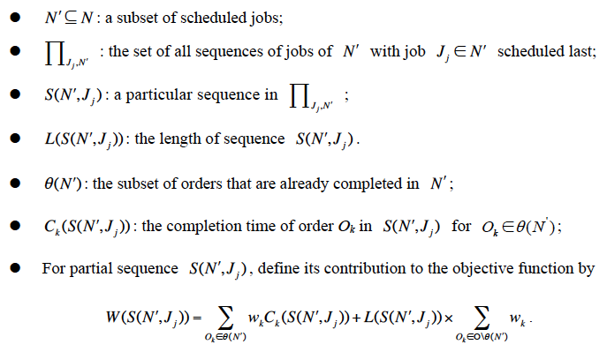
DP Formulation

Slide 25
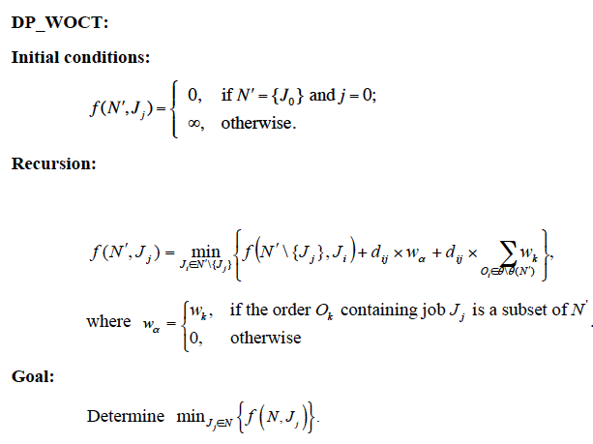
DP Formulation

Slide 26
Batch Scheduling to Minimize ΣC_{i}
Jobs are grouped into batches, each of which requires a setup time s
The length of a batch is the sum of s and the processing times of the jobs belonging to it
Jobs in the same batch share a common completion time

Slide 27
Batch Scheduling to Minimize ΣC_{i}
There is an optimal schedule in which the jobs are sequenced by the SPT rule
A batch consisting of J_{i}, J_{i+1}, …, J_{k-1}
What is their contribution to the objective function?

Slide 28
Batch Scheduling to Minimize ΣC_{i}
Define a weighted graph
Null node J_{n+1}
Find the shortest path
Solvable in polynomial time

Slide 29
Batch Scheduling to Minimize Σc_{i} Dynamic Programming
A batch consisting of J_{i}, J_{i+1}, …, J_{k-1}
Let g(i) be the optimal solution value for jobs {i, i+1, …, n+1}
g(n+1) = 0
g(i) = min_{k=i..n}{g(k) + }
Find g(1)
Required running time
Array size = O(n)
Each entry can be computed in O(n²) time, which can be reduced to O(n)
Overall running time = O(n²)

Slide 30
Assignment:
Define a dynamic program using the forward approach

Slide 31
Dijkstra’s All-Pair Shortest Path Algorithm
Let A(i, j, k) be the shortest path between node i and node j subject to the condition that the intermediate nodes belong to {1, 2, …, k}
A(i, j, 0) = d(i, j)
A(i, j, k) = min{A(i, j, k-1), A(i, k, k-1)+A(k, j, k-1)}
Find A(i, j, n) for all nodes i ≠ j
Required running time
Array size = O(n³)
Each entry can be computed in O(1) time
Overall running time = O(n³)
Initialization
Recursion
Objective

Slide 32
Longest common subsequence (LCS)
A string : A = b a c a d
A subsequence of A: deleting 0 or more symbols from A (not necessarily consecutive).
e.g. ad, ac, bac, acad, bacad, bcd.
Common subsequences of A = b a c a d and
B = a c c b a d c b: ad, ac, bac, acad.
The LCS of A and B: a c a d.

Slide 33
The LCS algorithm
Let A = a₁ a₂ … a_{m} and B = b₁ b₂ … b_{n}
Let L(i, j) denote the length of the LCS of a₁ a₂ … a_{i} and b₁ b₂ … b_{j.}
L(i, j) = L(i－1, j－1) + 1, if a_{i} = b_{j}
max{L(i, j－1), L(i－1, j)}, if a_{i} ≠ b_{j}
L(0, 0) = L(0, j) = L(i, 0) = 0 for 1≤i≤m, 1≤j≤n
Goal: Determine L(m, n)
Recursion
Initialization
Objective

Slide 34
Dynamic Programming
Not a specific algorithm, but a technique
Developed back in the day when “programming” meant “tabular method” (like linear programming)
Used for optimization problems: Find a solution with the optimal value
f(i, q)
Functions
State variables
L(i, j)

Slide 35
Dynamic programming approach for solving the LCS problem:
Time complexity is O(mn) because there are O(mn) entries, each of which is determined in constant time.
Calculation
Recursion

Slide 36
Tracing back in the LCS algorithm
e.g. A = b a c a d, B = a c c b a d c b
After all L_{i,j}’s have been found, we can trace back to find the longest common subsequence of A and B.

Slide 37
Longest palindrome subsequence (LPS)
A palindrome is a non-empty string over some alphabet that read the same forward and backward, like civic, racecar, and aibohphobia (fear of palindrome)
Given a string, design a dynamic program to find its longest palindrome subsequence
character → carac

Slide 38
0/1 knapsack problem Profit maximization
n objects , weight W₁, W₂, …,W_{n}
profit P₁, P₂, …,P_{n}
capacity M
maximize
subject to ≤ M
x_{i} = 0 or 1, 1≤i≤n
e. g.

Slide 39
0/1 knapsack problem Weight minimization
n objects , weight W₁, W₂, …,W_{n}
profit P₁, P₂, …,P_{n}
profit target P
Minimize the total weight of the collected items such that their total profit is at least P
Two knapsacks, with capacity W1 and W2 are available. We want to collect items to have the maximum total profit subject to the two knapsack capacities.

Slide 40
Multistage Graph
0/1 knapsack problem can be described by a multistage graph.

Slide 41
Subset Sum Problem
Given integers x₁, x₂, …, x_{n}, and integer bound B, is there a subset of integers whose sum is exactly B?
DP formulation: Define f(i, K) = “Y” if there is a subset of integers {x₁, x₂, …, x_{i}} whose sum is exactly K; “N”, otherwise.
f(0, 0) = “Y”
f(i, K) = “Y” if f(i-1, K-x_{i}) or f(i-1, K) is “Y”;
“N”, otherwise.
Find f(n, B)?

Slide 42
Subset Sum Problem
Given integers x₁=2, x₂=3, x₃=4, x₄=5, is there a subset with a sum of 9?
Entry (i, k): Answer to “Is there is a subset of {x₀, x₁, x₂, …, x_{i}}
whose sum is k?”
 | 0 | 1 | 2 | 3 | 4 | 5 | 6 | 7 | 8 | 9
x₀ | Y | N | N | N | N | N | N | N | N | N
x₁ | Y | N | Y | N | N | N | N | N | N | N
x₂ | Y | N | Y | Y | N | Y | N | N | N | N
x₃ | Y | N | Y | Y | Y | Y | Y | Y | N | Y
x₄ | Y | N | Y | Y | Y | Y | Y | Y | Y | Y

Slide 43
Multistage Graph
The 0/1 knapsack problem can be described using a multistage graph.

Slide 44
DP Approach
The longest path represents the optimal solution:
x₁=0, x₂=1, x₃=1
= 20+30 = 50
Let f (i, Q) be the value of an optimal solution to objects 1, 2,3, …, i with capacity Q.
f(i, Q) = max{ f (i-1, Q), f (i-1, Q-W_{i})+P_{i} }
The optimal solution is f (n, M).

Slide 45
Optimal binary search trees
e.g. binary search trees for 3, 7, 9, 12;

Slide 46
Optimal binary search trees
n identifiers : a₁ <a₂ <a₃ <…< a_{n}
P_{i}, 1≤i≤n : the probability that a_{i} is searched.
Q_{i}, 0≤i≤n : the probability that x is searched
where a_{i} < x < a_{i+1} (a₀=-∞, a_{n+1}=∞).

Slide 47
Identifiers : 4, 5, 8, 10, 11, 12, 14
Internal node : successful search, P_{i}
External node : unsuccessful search, Q_{i}
The expected cost of a binary tree:
The level of the root : 1

Slide 48
Dynamic Programming Approach
Let C(i, j) denote the cost of an optimal binary search tree containing a_{i},…,a_{j} .
The cost of the optimal binary search tree with a_{k} as its root :

Slide 49
General formula

Slide 50
Computation relationships of subtrees
e.g. n=4
Time complexity: O(n³)
when j-i=m, there are (n-m) C(i, j)’s to compute.
Each C(i, j) with j-i=m can be computed in O(m) time.

Slide 51
Matrix-chain multiplication
n matrices A₁, A₂, …, A_{n} with size
p₀ × p₁, p₁ × p₂, p₂ × p₃, …, p_{n-1} × p_{n}
To determine the multiplication order such that number of scalar multiplications is minimized.
To compute A_{i} × A_{i+1}, we need p_{i-1}p_{i}p_{i+1} scalar multiplications.
e.g. n=4, A₁: 3 × 5, A₂: 5 × 4, A₃: 4 × 2, A₄: 2 × 5
((A₁ × A₂) × A₃) × A₄, # of scalar multiplications:
3 * 5 * 4 + 3 * 4 * 2 + 3 * 2 * 5 = 114
(A₁ × (A₂ × A₃)) × A₄, # of scalar multiplications:
3 * 5 * 2 + 5 * 4 * 2 + 3 * 2 * 5 = 100
(A₁ × A₂) × (A₃ × A₄), # of scalar multiplications:
3 * 5 * 4 + 3 * 4 * 5 + 4 * 2 * 5 = 160

Slide 52
Let m(i, j) denote the minimum cost for computing
A_{i} × A_{i+1} × … × A_{j}
Computation sequence :
Time complexity : O(n³)

Slide 53
Applications in DNA Sequence Alignment

Slide 54
Some Remarks on the Design of DPs
In some problems, like Partition and Knapsack, the ordering of selected items is immaterial
In most problems, the ordering of the elements is however crucial. In such a case, to develop a “correct” DP, we need to find the correct ordering of the elements of concern.

Slide 55


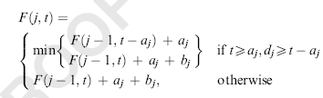
1|p_{i}=a_{i} or a_{i}+b_{i}|C_{max}
Minimizing the makespan
F(j,t): the optimal makespan for the first j jobs and
the completion time of the last early job is t

Slide 56
1|p_{i}=a_{i} or a_{i}+b_{i,} d_{i}=d|ΣC_{i}
Minimizing the sum of completion times
Lemma 2: The early jobs are sequenced in non-decreasing order of a_{i} and the late jobs in non-decreasing order of a_{i}+b_{i}.
F(j,t₁,t₂): the optimal makespan for the first j jobs, the completion
time of the last early job is t₁ and the completion time of the last
late job is t₂.

Slide 57
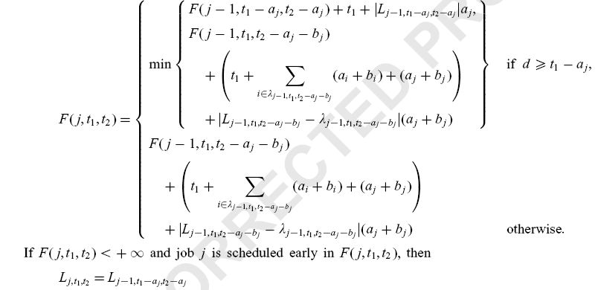

Slide 58
RP(2)||C_{max} with Two Dedicated Machines Subject to Fixed Job Sequences (RPD2|fjs|C_{max})

Slide 59
RPD2|fjs|C_{max}
Two sets of jobs, J₁={J_{1,1}, J_{1,2}, … , J_{1,n1}} of n₁ jobs and J₂={J_{2,1}, J_{2,2}, … , J_{2,n2}} of n₂ jobs to be processed on two parallel dedicated machines, M₁ and M₂, respectively
Each job J_{k,j} of J_{k} is characterized by processing length p_{k,j}, weight w_{k,j}, due date d_{k,j}, resource requirement α_{k,j}, and resource yield β_{k,j}
Given the initial resource level v₀, we want to determine a feasible schedule that is optimal for a regular objective function C_{max}, Σw_{j}C_{j}, Σw_{j}T_{j}, L_{max}, or Σw_{j}U_{j}

Slide 60

RPD2|fjs|C_{max}
M₁
M₂
O(2^{n}) choices lead to an exponential running time
M₁
M₂
M₁
M₂

Slide 61
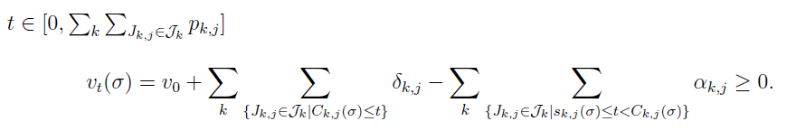
DP Algorithms for RPD2|fjs|γ
Define v_{t}(σ) as the resource level at time t in a particular schedule σ
Let s_{k,j}(σ) denote the starting time of job J_{k,j} in a particular schedule σ
Schedule σ is feasible if and only if

Slide 62
Dynamic Programming Algorithms
Lemma 1: If feasible schedules exist for RPD2|fjs|C_{max} with any regular objective function, the two machines cannot be simultaneously idle in any optimal schedule
Lemma 2: For RPD2|fjs|C_{max} with any regular objective function, there is an optimal schedule, if exists, in which the starting time of any job preceded by an idle time on one machine coincides with the completion of some job on the other machine
M₁
M₂

Slide 63

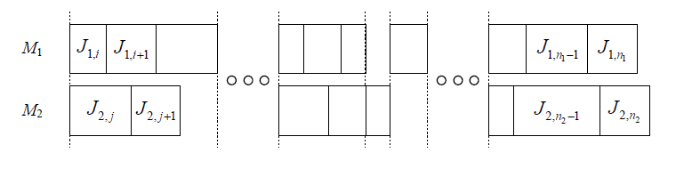
Backward DP
Define function g(i, j) for 1≦i≦n₁ and 1≦j≦n₂, as the optimal objective value for scheduling two subsequences of jobs (J_{1,i}, J_{1,i+1}, …, J_{1,n1}) and jobs (J_{1,j}, J_{1,j+1}, …, J_{1,n2}), subject to the resource level

Slide 64
Keys to the Design
The extra contribution made by each decision (recursion) to the objective function value should be easy to compute, independent of the details of the partial schedule
To attain this, a mechanism is required to know the processing length of a sub-schedule
Not to introduce temporal parameters into the dynamic program, we design a mechanism to “freeze” the processing length of a sub-schedule

Slide 65
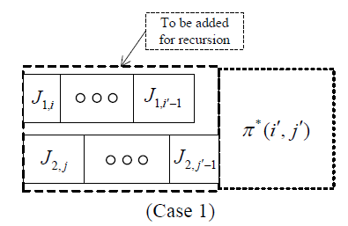
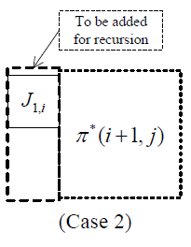
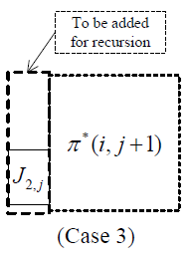
Backward DP
Denote the sub-schedule attaining the objective value of g(i, j) by π*(i, j)
Three types of recursion:

Slide 66
Backward DP
Block of case 1 must satisfy the following conditions:
[c1]: No idle time exists between any two adjacent jobs
[c2]: Job J_{1,i} and job J_{2,j} start at the same time
[c3]: Except for possibly J_{1,i'-1} and J_{2,j'-1}, no other pair of machine-1 and machine-2 jobs complete at the same time
[c4]: No job of (J_{1,i}, …, J_{1,i'-1}) starts at or later than the completion of J_{2,j'-1}, and no job of (J_{2,j}, …, J_{2,j'-1}) starts at or later than the completion of J_{1,i'-1}

Slide 67
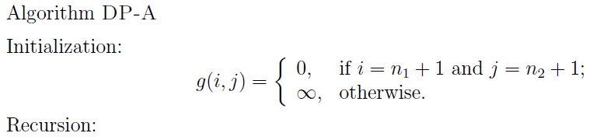
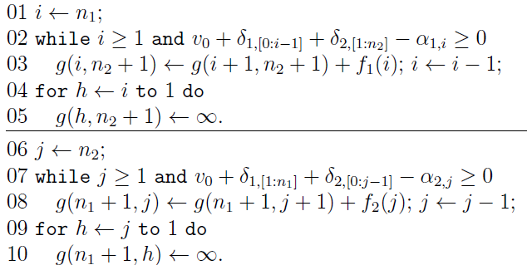

Slide 68
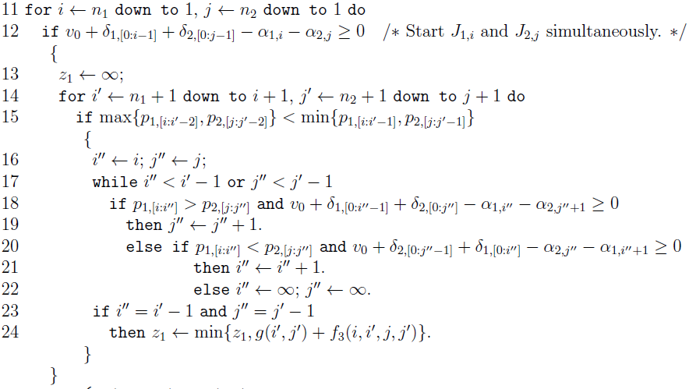

Slide 69
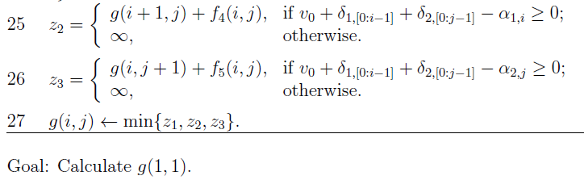
Overall running time:
Remark 1: The algorithm works for C_{max}, Σw_{j}C_{j} and L_{max}
Remark 2: For the case with a common job processing
time, the algorithm can be simplified to run in
O(n₁n₂) time

Slide 70
Σw_{j}T_{j} and Σw_{j}U_{j}
Unfortunately, the proposed DP does not work for the objective function of the total weighted tardiness or the weighted number of tardy jobs
The extra contribution made by each decision (recursion) to the objective function value cannot be determined, unless the details of the sub-schedules are kept along with the states

Slide 71
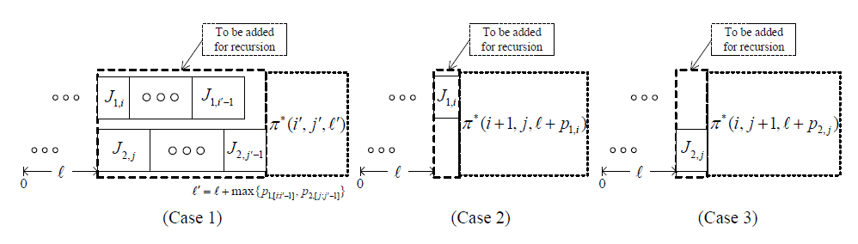
DPs for Σw_{j}T_{j} and Σw_{j}U_{j}
Define function g(i, j, l) for 1≦i≦n₁, 1≦j≦n₂, and max{p_{1,[0:i-1]},p_{2,[0:j-1]}}≦ l ≦p_{1,[0:i-1]}+p_{2,[0:j-1]}, as the optimal objective value for scheduling two subsequences (J_{1,i}, J_{1,i+1}, …, J_{1,n1}) and (J_{2,j}, J_{2,j+1}, …, J_{2,n2}), subject to the condition that the lead time before the constructed sub-schedule is exactly l

Slide 72
DPs for Σw_{j}T_{j} and Σw_{j}U_{j}
The running time required for computing function g(i, j, l) is
which is pseudo-polynomial, or strictly speaking, exponential in the input length
If all jobs have a common processing length, then the running time will become polynomial

Slide 73
Batch Scheduling to Minimize ΣC_{i}
Jobs are grouped into batches, each of which requires a setup time s
The length of a batch is the sum of s and the processing times of the jobs belonging to it
Jobs in the same batch share a common completion time

Slide 74
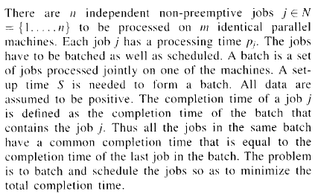
Parallel-machine batching and scheduling to minimize total completion time

Slide 75
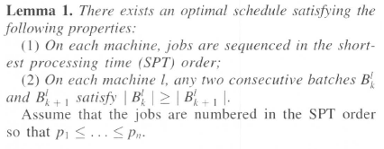


Slide 76
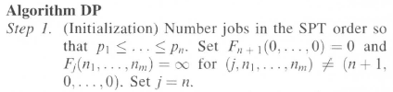
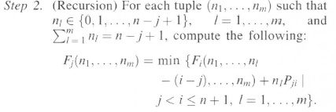
Define f_{j}(n₁,n₂,…,n_{m}) as the minimal total completion time of jobs
{j, j+1,…, n} subject to the condition that there are n_{l} jobs on machine l

Slide 77
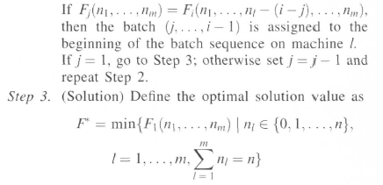
Time Complexity: O(mn^{m+1})

Slide 78
Film Production Problem
actor i | Shooting day j 1 2 3 4 5 6 7 8 | Holding Cost c_{i}
1 | 1 1 1 0 0 1 0 0 | 810
2 | 1 1 0 0 0 1 1 0 | 700
3 | 0 1 0 1 0 0 0 1 | 910
4 | 0 1 0 1 1 1 1 0 | 880
5 | 0 1 0 0 0 0 0 1 | 400
6 | 0 0 1 1 0 0 0 1 | 610

Slide 79
Film Production Problem
actor i | Shooting day j 1 2 3 4 5 6 7 8 | Holding Cost c_{i}
1 | 1 1 1 0 0 1 0 0 | 810
2 | 1 1 0 0 0 1 1 0 | 700
3 | 0 1 0 1 0 0 0 1 | 910
4 | 0 1 0 1 1 1 1 0 | 880
5 | 0 1 0 0 0 0 0 1 | 400
6 | 0 0 1 1 0 0 0 1 | 610

Slide 80
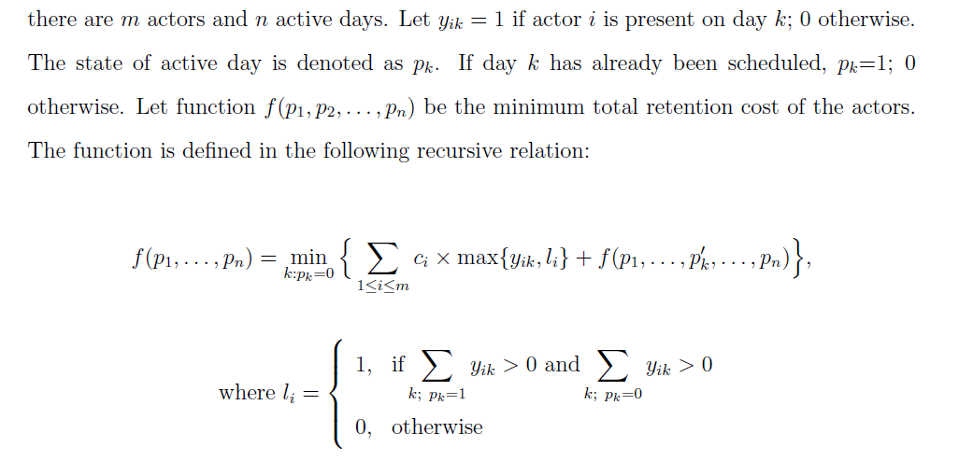

Slide 81
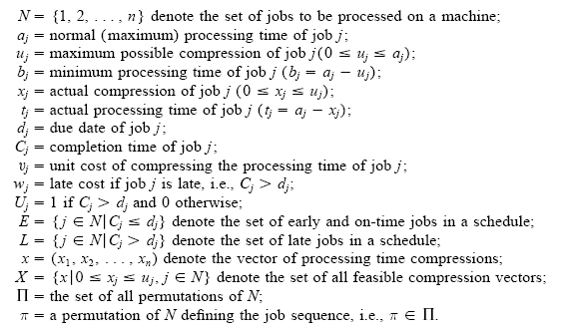
Scheduling to Minimize the Total Compression and Late Costs

Slide 82


Slide 83
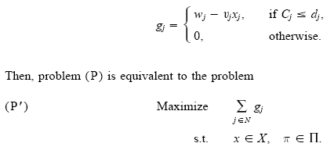
Let g_{j} denote the profit earned by job j ∈ N in a given schedule π ∈ Π,

Slide 84


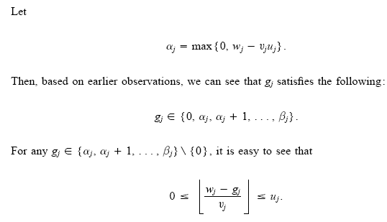
The maximum profit attainable by job j.
Define β_{max} = max{β_{j}}, then
All possible profits that job j can make →

Slide 85
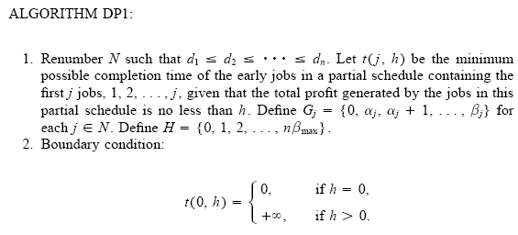

Slide 86

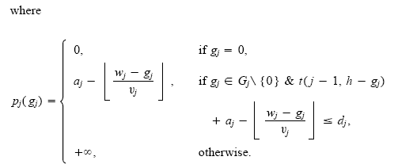

Slide 87
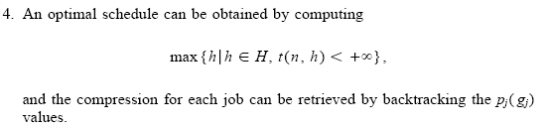
Time complexity:

